Slide 1

Data Visualization and Data Analysis of office location preferences at M.N. Dastur &Co.
Capstone Project- The battle of neighborhoods
Name : Supratim Sengupta
Metallurgical and Material Science major
IIT Bombay
Language of code: Python

Slide 2
Introduction
Being a consultancy company based on the eastern coalfield belt of India they have taken an approach of creating a local community of companies together coming up with the solutions of certain complex metallurgical problems. The main approach is creating independent spaces for the companies to work in unison alongside each other.
Expansion due to penetration in fields of oil and gas
Determining locational preference for new expansion in Kolkata
Using Python to visualize and analyze current locational data
Business Problem
Board of Directors at M.N. dastur
Duplicated for other organizations with equivalent expansion policies
Interest of project

Slide 3
Dataset Exploration
Scraping of data from the official website of the organization--- for present data
Kolkata----Headquarters
Bengaluru
New Delhi
Mumbai
Chennai
Bhubaneshwar
Chandni Chowk
Rabindra Sadan
Bhowanipore
New town
Jadavpur
Birati
India
Japan
Germany
United States
UAE
Finding the latitudes and longitudes using Geopy
Plot maps of the scrapped locations of data throughout the country as well as within Kolkata using Folium

Slide 4
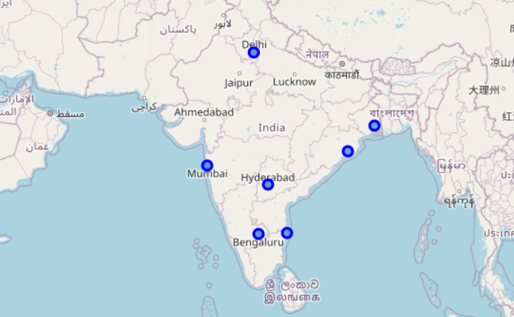
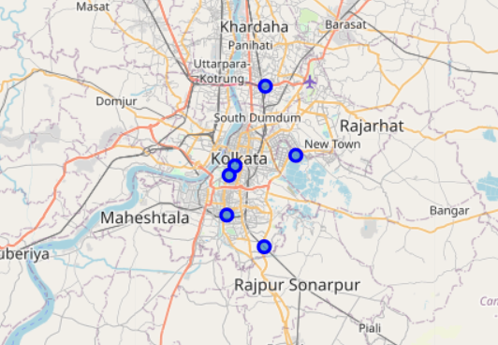
Foursquare data for each office:
100 venues in the 400m closest to the offices listed in Kolkata.
final output is a Data Frame containing these details which can then be used for
Using the latitude and longitude found in the previous section, query Foursquare using the explore API to find up to 100 local popular venues.
Group the data produced by office name and shape using one hot encoding.
Find the 10 most common venues for each office and create a final DataFrame with this data for analysis.

Slide 5
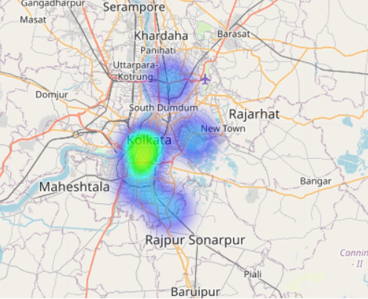
Methodology :
Data has been collected from the M.N.Dastur website for Kolkata based offices and exact locations added
The areas around each office will be characterised using data from Foursquare for venue types in a 400m radius around each. This radius was chosen as the “ ped shed " which is deemed as equivalent to 5 mins walk.
The data will be explored using heatmapping and K-means clustering in order to find similarities between the localities of the various M.N.Dastur offices in Kolkata
After performing of the heat map, it can be seen that there are hotspots in the southern area of Kolkata namely the areas near Chandni chowk to Rabindra sadan within which we can see the technological hub area of park street and esplanade all the way up to tollygunge.

Slide 6
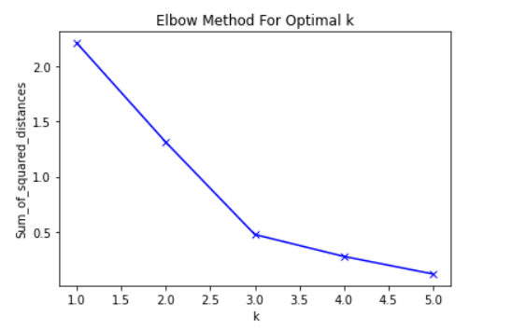
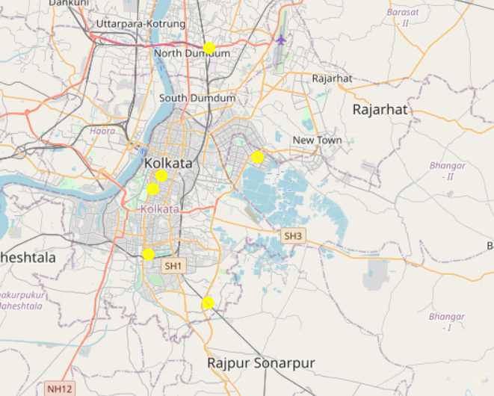
Clustering :
After clustering done on the basis of k-means algorithm we can see there is majority of cluster 1(label 0) within which majority of the current office location falls
No of Clusters=3
Comparing the three largest clusters (clusters 1,2 and 3 in order) we note the following:
The largest cluster share a number of features. ATM, Asian restaurants ,BBQ joints, beer garden comes under these popular features.
Being specific about the type of each area beyond these shared features is difficult but we note a few differences using the top ten venue types for each cluster:
Cluster 1 (label 0) has the "core" venue types one might except, but has less variety in other areas i.e., types of variety in restaurants and movie theatres and lounges i.e., it lacks some form of entertainment

Slide 7
Conclusion:
We have been able to show that the current offices fall into three main types of neighbourhood based on the types of venues in those neighbourhoods. This analysis might allow the key stakeholder here, of M.N.Dastur themselves, to rate potential locations for future offices.
Key things to explore further would be how to define / subset the more successful offices to better inform the clustering process. Also, to explore the distances from commuter train stations / key roads, distance from the manufacturing and marketing bases of the popular clients in the field of oil and gas where they are aiming to penetrate into which will most likely have impact here also.

Slide 8
THANK YOU

